Slide 1

MIS 321
Plan Transition & Analyze

Slide 2
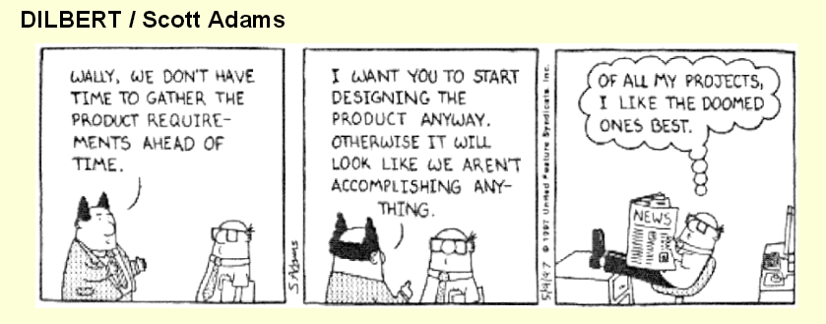


Slide 3
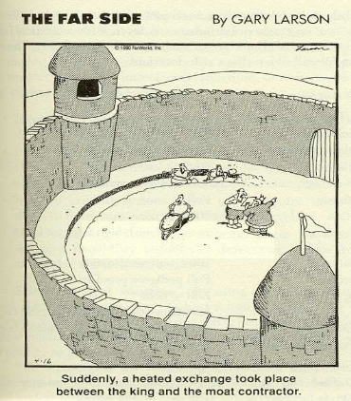

Slide 4
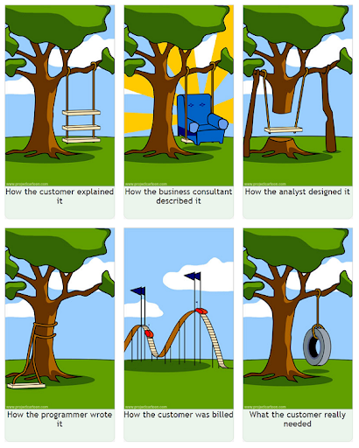

Slide 5
Stages
Plan –Determine business goals, scope and HLRs
Analyze – Gather, identify, analyze and manage the requirements. Evaluate packaged software and select technology infrastructure. Determine environmental and process needs to support the new capability.

Slide 6
Stages (cont.)
Design – Design the applications, technical architecture, technical infrastructure and application training.
Build – Develop the application, technical architecture, technical infrastructure and app training.
Test – Test components built by workstreams
Deploy – Roll out the app.

Slide 7
Plan
Analyze
Design
Build
Charter (Scope)
Conceptual Models
Logical Models
Physical Models
High Level Requirements
Product Requirements
Product and Technical Requirements
Product
Requirements Traceability Matrix

Slide 8
Transitioning from Plan to Analyze
Set Up Transition Meeting
Conduct Transition Meeting
Clarify Planning Deliverables
Accept Planning Deliverables
Repeat until the planning deliverables are fully understood by the requirements team

Slide 9
Solution Blueprint
Describes the application, business process, technology, change enablement and security aspects that must be incorporated in the solution.
Application Section – Identifies applications in the solution and the relationship between them
Business Process Section – Depicts the future business process at a high level
Technology Section – Describes a vision of the technical working environment
Change Enablement Section – Identifies high-level approach to enabling users and ensuring change adoption
Solution Security Section – Describes how the solution meets legal, regulatory and client policies related to information security.

Slide 10
Analyze
Typical Deliverables
Requirements *
Use Cases *
User Analysis
Integration Conceptual Design
Conceptual Data Model *
Class Design
Interaction Diagram
Business Process Design
Solution Metrics
Test Plan *
* For our group projects you should at least have these artifacts at the end of the analyze phase.

Slide 11
Analyze Users and Sites
Understand users, roles, goals and how they interact with the system
Access user experience with current system
Access user experience with similar systems in the market
Identify major user scenarios and users perspective on each

Slide 12
Business Processes
Review / Understand the current business process and the impact of the new system changes to that process
Create the new business process design
Define how the new business processes interact with various roles and applications
Define process flows and dependencies
Define business rules that must be followed

Slide 13
Requirements
Include functional, quality, interface, security, content, technical, training, deployment and all other requirements and constraints stated by stakeholders.
Includes unstated requirements

Slide 14
Good Requirements
Necessary
Does not restrict design (what not how)
Verifiable (speak in positives)
Easy to understand by all
Short sentences, small words
Avoid buzz words
Achievable
Specify 1 and only 1 function
Unique
Traceable

Slide 15
Be on the Look Out
Missing Information
Design
Verbosity
Vague Words (Efficient, Effective, Minimize, etc)
Shall vs Will vs Should

Slide 16
Example Requirements
The ATM shall reject withdrawal requests if the amount requested is not divisible by 20.
The ATM shall produce a receipt for use by bank patrons if a transaction is completed.
The ATM shall be developed in accordance with ISO9001 Quality System Management Guidelines.

Slide 17
Traceability
Use a tool (ex. Reg-Pro) or artifact to maintain traceability
Bi-Directional Traceability applies to vertical traceability and at a minimum needs to be implemented forward and backward (i.e. from requirements to end products and from end product to requirements.
Vertical Traceability identifies the origin of items (e.g. customer needs) and follows these same items as they travel through the hierarchy of the solution blueprint, to the tasks in the work plan to the product components and eventually back to the customer.

Slide 18
Questions?

